Slide 1

NBA Player Data Analysis
Ben T, David A, Elvis M

Slide 2
Data Sources
We used multiple documents from sources like Kaggle, Data.world, and sports-statistics.com.
Our data sets were titled NBA Demographics, NBA Team Names, Player Info, Player Salaries, and Stadiums.
Our focus was the 1999 season to the 2020 season.
Information from seasons prior to 1999 and after 2020 was dropped due to inconsistency and incompletion of the data available.

Slide 3
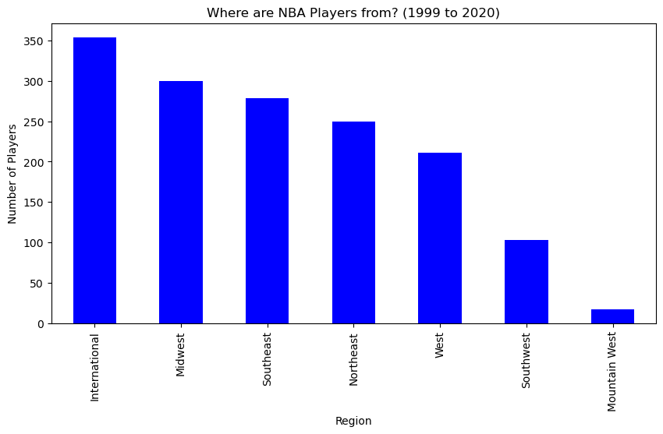
What Regions are NBA Players coming from over time?
Looking back on the last two decades, we see how the international player count has grown to be the most significant by far.
When considering the location of these regions, we notice that the east coast, comprised of the Northeast and Southeast regions, contributes the majority of American players.
As we work our way west over the country, player contributions trend downward per region.
Generally speaking, the East contributes more players to the NBA than the west of America.

Slide 4
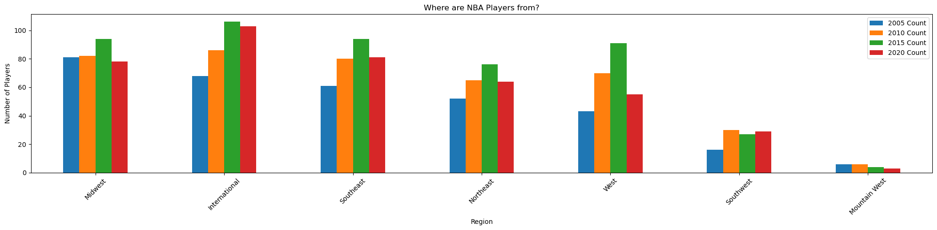
What Regions are NBA Players coming from?
Here we see a snapshot of where the players in the league are from every 5 years.
We can see large increases in both international players and players from the Southeast region over time.
One region that hasn’t produced much NBA talent appears to be the Mountain West region, since 2005 they have the lowest number of players in the NBA.
Both the Midwest and the Western region see some wobble, but the player count ends up similar.
The Northeast region is a moderate contributor to the league, with some small upticks in recent years.

Slide 5
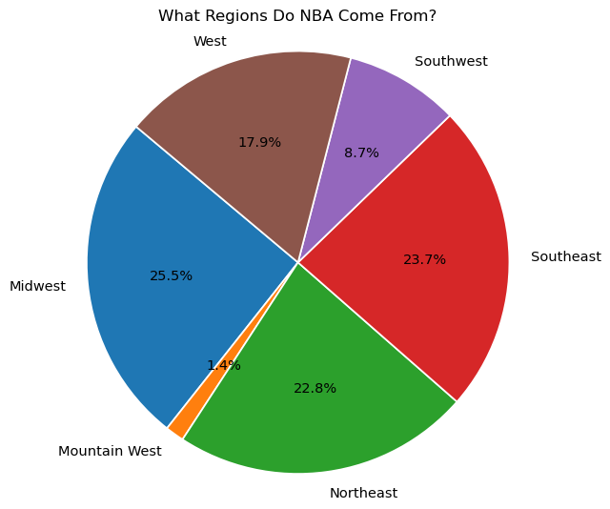
What US Regions are NBA Players coming from?
This graph compared to the previous notably excluded international data.
The Midwest, Southeast, and Northeast contribute the majority of players to the league respectively, with the West providing a substantial amount but to a lesser degree than those previous.
Southwest has a reduced contribution compared to the rest, with the Mountain West bordering on negligible.

Slide 6
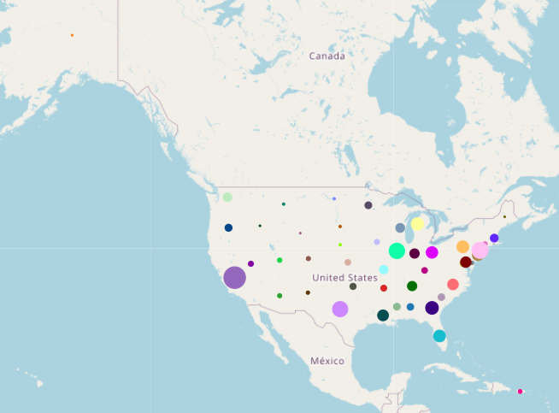
What US states are players from?
Dot size roughly correlates with number of players contributed per state.
There’s exactly one player from Alaska!

Slide 7
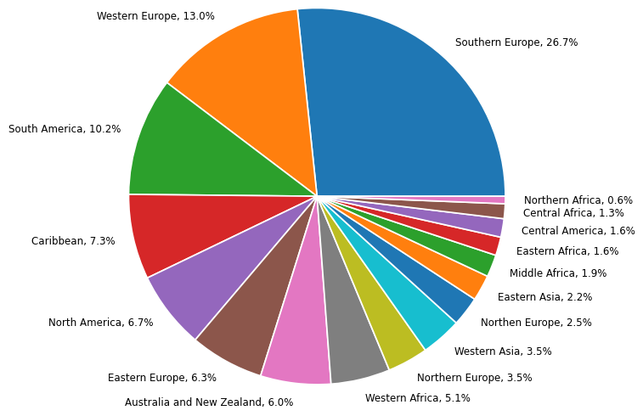
International Player Regions
European countries tend to produce the most international NBA players, specifically the Southern European Region, which has produced 26.7% of international players since 2000.
Asian countries have produced the least amount of NBA players in recent years, which is surprising considering they have the largest populations.

Slide 8
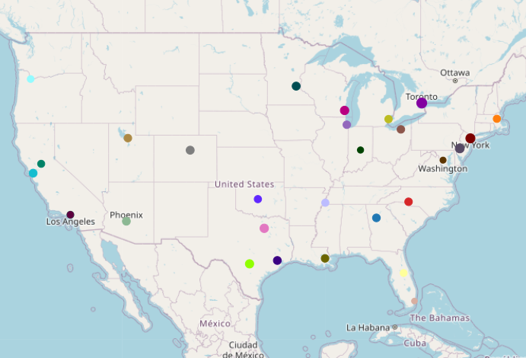
What teams do international players play for?
All 30 teams have international players with a mean of 25.
The Toronto Raptors have signed the most international players in the last 20 seasons at 44.
The Miami Heat have signed the fewest international players in the same time frame at 14.

Slide 9
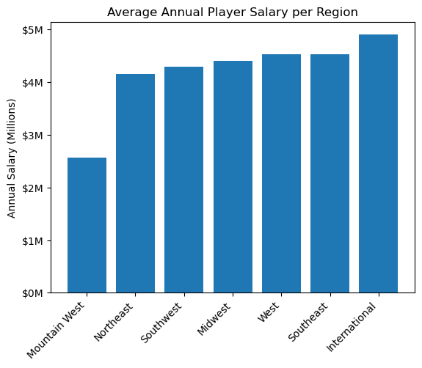
Avg. Annual Salaries based on Region
When looking at the average annual salaries of players from each region over the last 20 years, most regions outside of the Mountain West region are relatively similar.

Slide 10
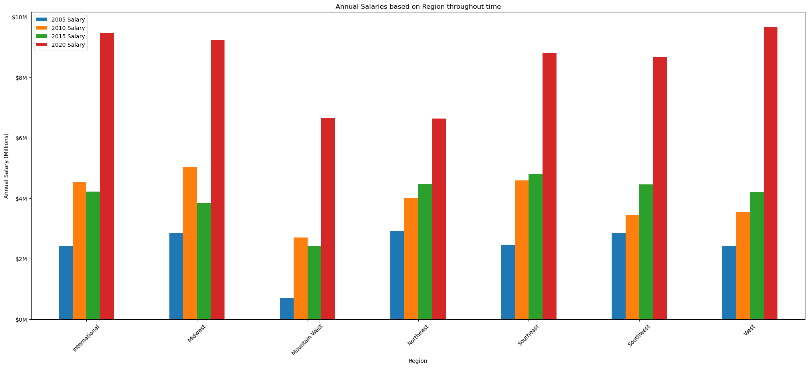
Avg. Salaries of Players Based on Region Over Time
While player salaries have grown tremendously in recent years, the Northeast region has not had the same amount of growth when compared to other regions
Notes:
New collective bargaining agreement caused a huge recent increase (2020 data) due to players sharing 50% of the revenue of the NBA. Wasn’t the case in 2015
Outside of political shifts, further analysis could be warranted comparing viewership changed over time in tandem with these salary changes.

Slide 11

The Journey
Some reflections from the process:
When merging data don't assume that different sources follow the same naming conventions. To make the data merge, each file needed standardized formatting.
Conciseness in data sources matters, we started with far too many data sets initially and were looking at topics with too much breadth.
Narrowing our investigative focus allowed us to narrow our field of interest for raw data, which in turn made it easier to handle.
First steps collaborating on Github were occasionally rocky. Improving our coordination across multiple participants would allow us to push, pull, and generally manage our project more smoothly.

Slide 12
The Journey
Some reflections from the process:
When merging data don't assume that different sources follow the same naming conventions. To make the data merge, each file needed standardized formatting.
Conciseness in data sources matters, we started with far too many data sets initially and were looking at topics with too much breadth.
Narrowing our investigative focus allowed us to narrow our field of interest for raw data, which in turn made it easier to handle.
First steps collaborating on Github were occasionally rocky. Improving our coordination across multiple participants would allow us to push, pull, and generally manage our project more smoothly.

